Slide 1
Evaluating the SDGs: Why should the GoP consider an
evaluation of the SDGs now?
NEDA, 6th M&E network
December 6, 2016, Manila

Slide 2
Background: MDGs vs SDGs
Despite overall progress in terms of national MDGs aggregates inequalities between different population groups have grown.
Agenda 2030 calls for leaving “no one behind” and reaching the ones furthest behind first”. Central to SDG 5 and 10 while reflected in all goals
Evaluation, Equality and Equity at the center: understanding how and why.
Government equitable development approaches to programming and policy work from an equity work is still incipient and localized.

Slide 3
What is different?
Tracking progress on average, focus on aggregate
‘commitment of leaving no one behind’
Focus on extent to which targets have been achieved
focus on extent to which outcomes are sustainable over time
Recognition of interlinkages
cross-cutting SDGs
Independent assessments of each of the 8 MDGs

Slide 4
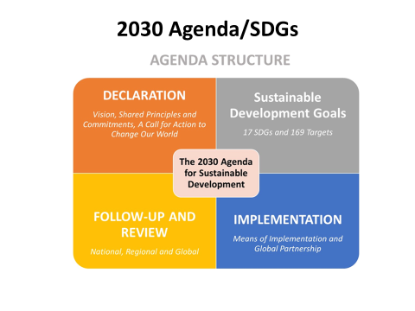
Evaluation integrated in SDGs
Evaluation has been integrated in the 2030 Agenda:
“Follow-up and review processes at all levels will be guided by the following principles:
[…]

Slide 5
Principles
A robust, effective, inclusive and transparent follow-up and review framework, operating at the national, regional and global levels
voluntary and country-owned
open, inclusive and transparent, and support the participation of all people and all stakeholders
build on existing platforms and processes, avoid duplication, respond to national circumstances

Slide 6
They will be rigorous and based on evidence, informed by country-led evaluations and data which is high-quality, accessible, timely, reliable and disaggregated by income, sex, age, race, ethnicity, migration status, disability and geographic location and other characteristics relevant in national contexts.
They will require enhanced capacity-building support for developing countries, including the strengthening of national data systems and evaluation frameworks.
[…]”

Slide 7
Evaluating SDGs
Can inform and improve interventions
(through feedback about their relevance, impact, effectiveness, efficiency, sustainability and understanding what works and what not)
Enables to understand how and why targets are not being achieved
Is an essential part of any accountability system
Creates incentives for effectiveness, transparency and accountability
Promotes stakeholder engagement / empowerment
Notes:
Evaluating SDG policies and programmes
The 2030 Agenda equally acknowledges the importance of evaluation and that of evaluation programmes that can help improve SDG policies through the assessment of their relevance, impact, effectiveness, efficiency and sustainability. UNEG defines the role of evaluation for meeting development objectives as follows: “Evaluation forms a natural learning and feedback bridge linking the monitoring and accountability functions. It is an essential part of any accountability system as it generates the credible, critical information that everybody needs to know – on what and how we are doing - in order to decide on how to move forward together. Monitoring is necessary and important to show if targets are being achieved or not. Equally important, rigorous evaluation needs to be combined with monitoring, so that we can understand how and why targets are or are not being achieved, where improvements are needed and what actions should be taken to perform more effectively”.
It is being argued that, in the context of the follow-up and review for the 2030 Agenda, evaluation will be crucial “because the new accountability framework will not be legally binding; it will rely on political will and persuasion. By assessing how programmes and policies are contributing to results, evaluation can help establish incentives for effectiveness, transparency and accountability.” (Source: UNEG report Evaluation Changes Lives) It can also empower people through more participatory approaches in the area of evaluation.

Slide 8
Purpose first - Why evaluate?
Making a decision
Enable managers and partners to make decisions and plan strategically
When evaluation used effectively
Support to make a decision on programme improvement, learning, knowledge generation and accountability.
Credible, reliable and useful evidence based information
How to use evaluation effectively
What do you need to know to inform the policy/ programme decision?
Notes:
Again, evaluation is to make a decision about your project and programme. Thus, it should have a purpose and be used effectively.
Perhaps, much easier to think it from the worst case scenario like the slide before. Evaluation was conducted without particular purpose (as part of administrative process) because it was asked to do. You conducted it because you were asked, so you were very happy to get it done, so why should I look at it?
Unfortunately many evaluations are like this – conducting an evaluation for the sake of conducting.
But the real programme manager wants to improve the people’s lives. To do that, you need to constantly improve the quality of your programme and project.
To do that, what do I need to know about my own project and programme?

Slide 9
Opportunities
New evidence generation governance
National development policies informed by country led evaluations -focusing on equity
Demand for independent, credible and useful evaluations for evidence-based policy making.
Assessing results at strategic and programmatic levels, and understand how development org. are contributing to SDGs.
Putting equity at the center from evaluation planning to use-
Participatory and utilization focused methods
Partnerships: Gov’s, Corporate and CSO supported by UN agencies

Slide 10
Philippines development plan strategic framework

Slide 11
Challenges
Challenges: Difficult to assess the achievement of SDGs. Why?
More emphasis on developing and formulating SDGs than on how to evaluate them.
Too many goals, indicators and targets.
Multiplicity of programs, policies and strat­egies. national (Gov, UN and donors)
Absence of clear consensus on benchmarks, indicators and success criteria.

Slide 12
Challenges
Challenges: Difficult to assess the achievement of SDGs. Why?
How to track progress in implementing SDGs and ensure that no one is left behind? From linear to complex
Limited M&E systems in place to measure such complexi­ties (e.g. Indonesia compatibility & Pacific paper-based data collection)

Slide 13
Challenges
Uneven understanding among stakeholders (Governments, our staff and our partners) regarding issues related to equity and equality.
Lack of reliable indicators (quant & qualitative measure change), baselines, targets and means of verification which are properly disaggregated and consistently collected
Tight evaluation timelines and budgets that don’t allows us to ponder equity issues.
Political sensitivities When demonstrating that poorest or most remote children receive less support than those that receive more support.

Slide 14
Difficult to assess the achievement of SDGs. Why?
Interdependency: Cause-and-effect analyses versus multidirectional effects.
Establishing causality and changes is hard when assuming linear models; it will be exponentially harder in complex systems.
Data variability – reliability
Tyranny of aggregation- national survey data is important but contextualization and analysis is needed.
Which populations groups (poverty, ethnicity, gender, disability, migrant, age, etc…)

Slide 15
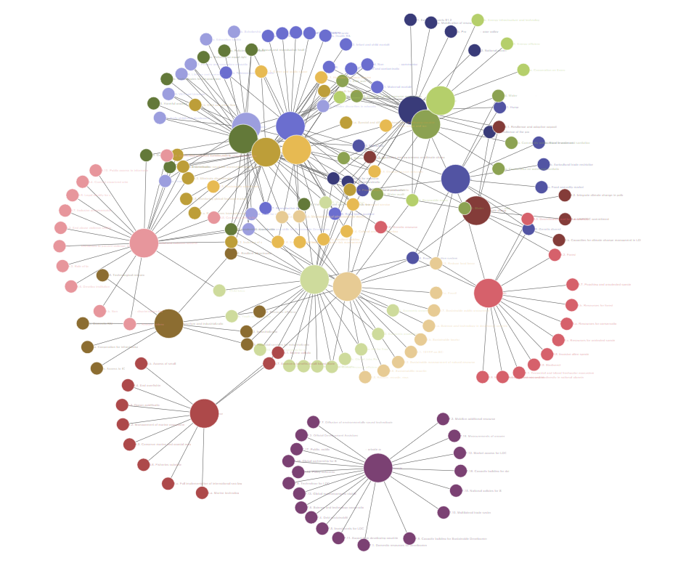
Interdependency Multidirectional effects
Systems can help to understand how complexity occurs to create function and progress for the SDGs
www.peleah.me

Slide 16
What will it require for us to happen? Where to focus on initially?
Equity-focussed analysis
Equity-sensitive data collection techniques (mixed methods)
Recognizing complexity of the evaluated phenomena
Key stakeholders engagement
An equity-sensitive, gender-balanced evaluation team
The assessment of the intervention contribution in improving the lives of vulnerable groups

Slide 17
Understanding complexities in national development policies
Interconnected national policies and strategies
Sub-national differences
Context-sensitive pathways
Trans-boundary dynamics
Interventions unfold in unpredictable ways

Slide 18
Introduce new approaches
SYSTEM THINKING APPROACH
bottleneck analysis
outcome mapping
developmental evaluation
→ More responsive evaluations
PROCESS EVALUATION
focus on “nodes” of interest (e.g., identity cards)
how results are achieved
Shifting from result-based management to adaptive management…

Slide 19
Evaluability
“The extent to which an activity or project can be evaluated in a reliable and credible manner” OECD DAC
Not all interventions can be evaluated. It is important to assess the evaluability potential of each intervention.
Can UN agencies contribution to equity and the SDGs be evaluated?
Quality / Adequacy of Programme Design
Availability & validity of “quality” info. & data
Conduciveness of the context

Slide 20
Evaluability
Does the quality of the design of the Strategy, Policy, Program allow for an evaluation?
Is Government and UN contribution to equity and the SDGs verifiable based on the planned data collection systems?
Would an evaluation be feasible, credible and useful?

Slide 21
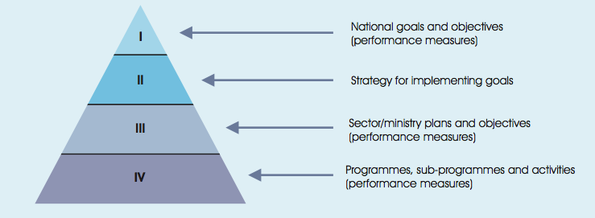
Where to focus? M&E systems needed
❶ Integrated framework
Levels of an integrated M&E framework
Source: UNEG, NECD: Practical tips
Notes:
The mainstreaming of the SDGs into planning processes is expected to happen at various levels and may require an integrated M&E system where identified objectives and performance reporting are aligned between these levels: national, sectoral, and programme, sub-programme and activities. These critical levels are illustrated in the above diagram.

Slide 22
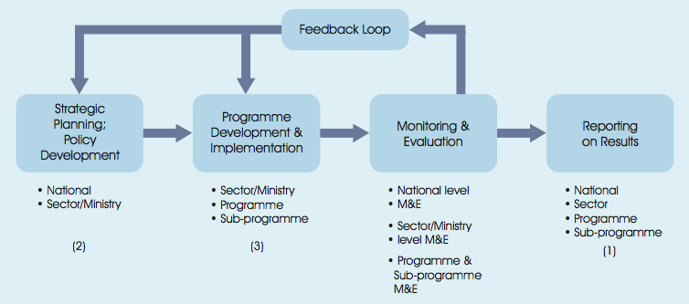
❶ Integrated framework
Use of M&E information
Source: UNEG, NECD: Practical tips
Notes:
M&E information produced at these different levels can be used for reporting, accountability and for management purposes informing policy/programme design, budget development, and subsequent improvements and oversight.

Slide 23
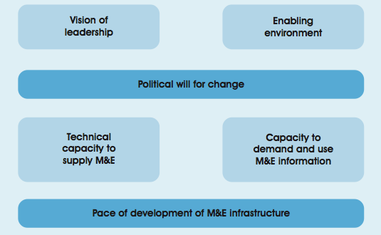
❷ Building blocks
Overriding influences and building blocks for a M&E system
2 overridding influences
Source: UNEG, NECD: Practical tips
4 building blocks
Notes:
The UNEG guide conceptualizes a national M&E system as “resting on two overriding influences: the political will for change within a country; and the pace of development of M&E infrastructure” which provide a foundation for four essential building blocks:
Vision of leadership within the country;
An enabling environment for an M&E system to develop and function;
The capacity to supply M&E information - the technical capacity to measure performance and provide credible information in a timely way;
The capacity within the system to demand and use M&E information – key users being government institutions, ministries, citizens, the media and other stakeholders, as civil society and donors.

Slide 24
❸ Infrastructure
Main components of M&E infrastructure
Policies, guidelines and guidance for M&E
Performance frameworks and KPIs
Performance measurements and data development strategy
Institutional arrangements
Training strategy
Monitoring of the strategy of M&E development and oversight over the quality of M&E
Source: UNEG, NECD: Practical tips
Notes:
Main components of M&E infrastructure
Drawing on a range of real case studies, the UNEG guide identifies several main components of M&E infrastructure:
1. The policies, guidelines and guidance for M&E that set the expectations about what should be measured, monitored and reported, how frequently, etc. with the central agency (for example, the ministry of finance or planning) often taking the lead.
2. A clear articulation of goals, objectives and expected key results for each level of the public sector, performance frameworks and KPIs at national, sectoral, ministerial and programme levels.
3. A performance measurement strategy that identifies how indicators can use data from performance monitoring, evaluation and special studies at different levels (with central agency and ministries responsible for respective levels) and a data development strategy supported by a national statistical office.
4. Institutional arrangements to develop and implement the M&E system (i.e., M&E units initially in pilot ministries, as well as in a central agency M&E unit).
5. A training strategy to provide M&E technical training addressing supply and demand sides (M&E officers, analysts and those tasked with developing data systems, as well as managers, senior officials and other key stakeholders).
6. Monitoring of the progress of M&E development and oversight over the quality of M&E by key officials led by central agencies and national audit offices.
Source: UNEG, NECD: Practical tips

Slide 25
Conclusions: evaluation can contribute to strengthening delivery of the 2030 agenda. How?
Being evaluation ready!
Supporting effective development through evaluation
To achieve Agenda 2030, we need to know what works and why – also, what doesn’t work and how to fix it.
Evaluation brings meaning to metrics
Statistics track what was achieved; evaluation can explain how and why these achievements were attained.
Empowering countries through evaluation
Supporting countries’ efforts to build their capacities to demand and undertake high-quality evaluations and use the evidence generated.
Empowering people – including children and young people - through evaluation
Helping people understand how decisions and actions affect them and how to participate in decision-making.

Slide 26
Critical success factors:
Drivers
Uses
Leadership
Commitment
Resourcing
Accountability
Technical capacity
Infrastructure
Infrastructure to use M&E information
Oversight
Values and ethics
Sustainability

